Slide 1
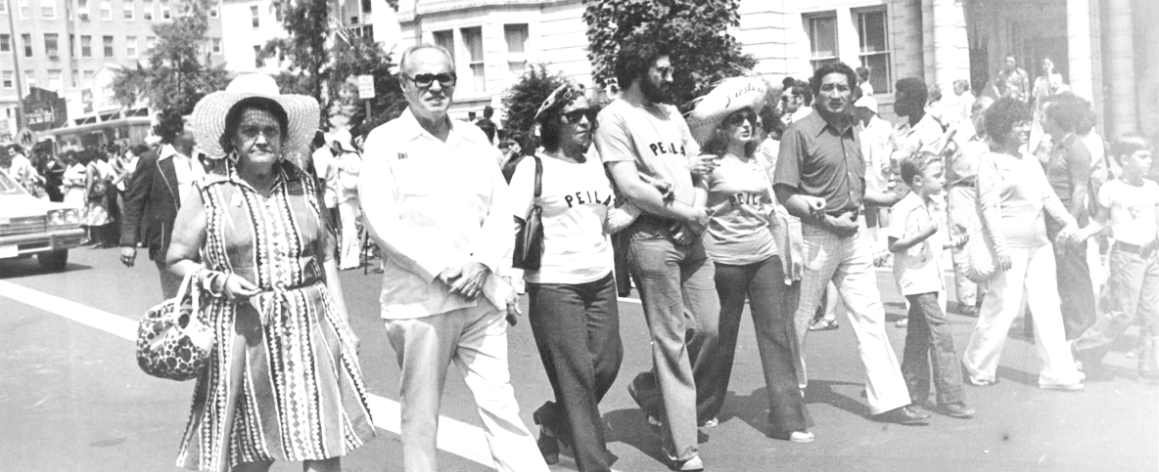
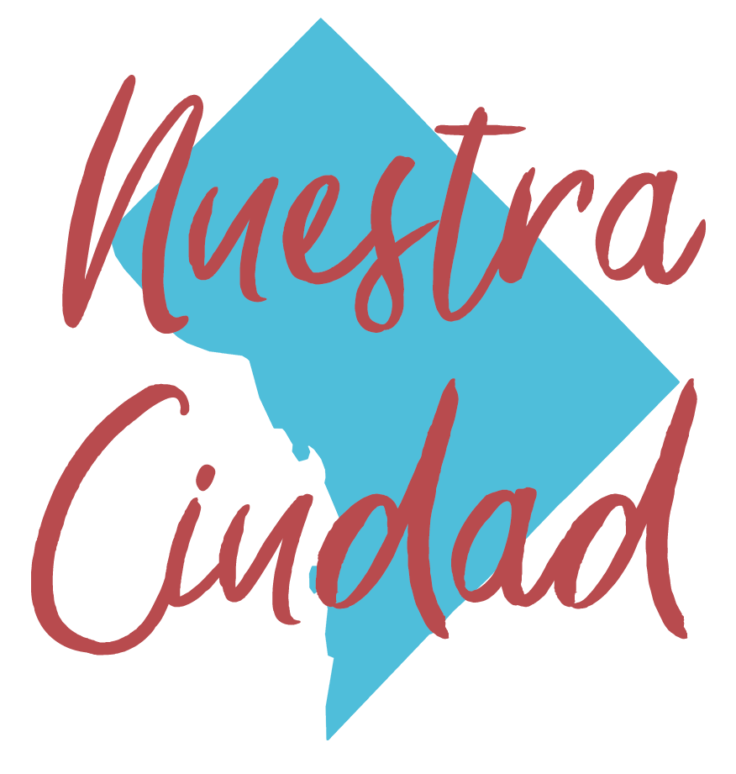
Call to Action: Lessons from 1970s
Latino Student Activism
Presenters:
Sonia Gutiérrez
José Sueiro
Pedro Avilés
With a response from CR graduate
Vanessa Magaña

Slide 2
Welcome
Allison Kokkoros, CEO
Carlos Rosario International PCS

Slide 3
Overview of Nuestra Ciudad,
Panelist Introductions
Naomi Ayala, Collaborator

Slide 4
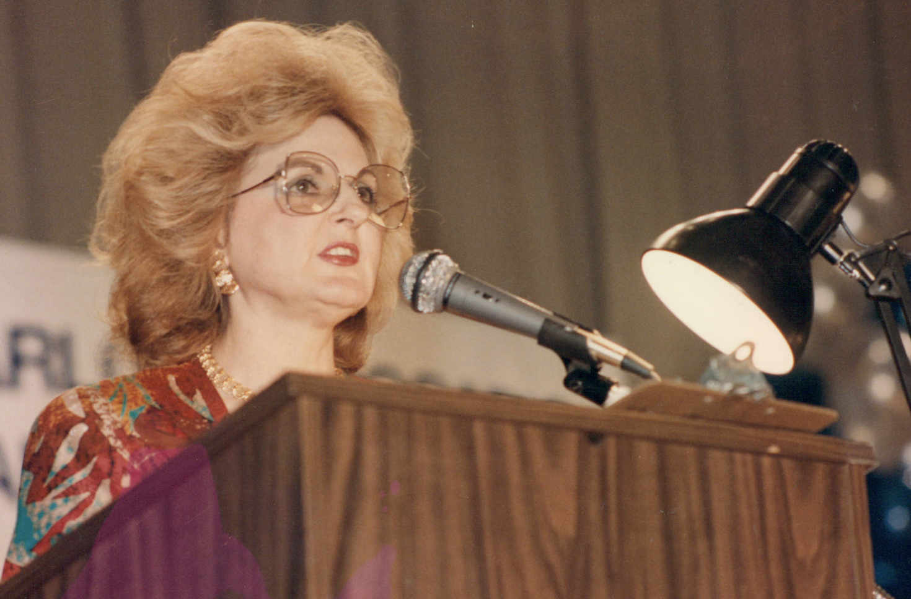
Challenges Faced by Latinos in the 1970s
Sonia Gutiérrez
Founder, Carlos Rosario International PCS

Slide 5
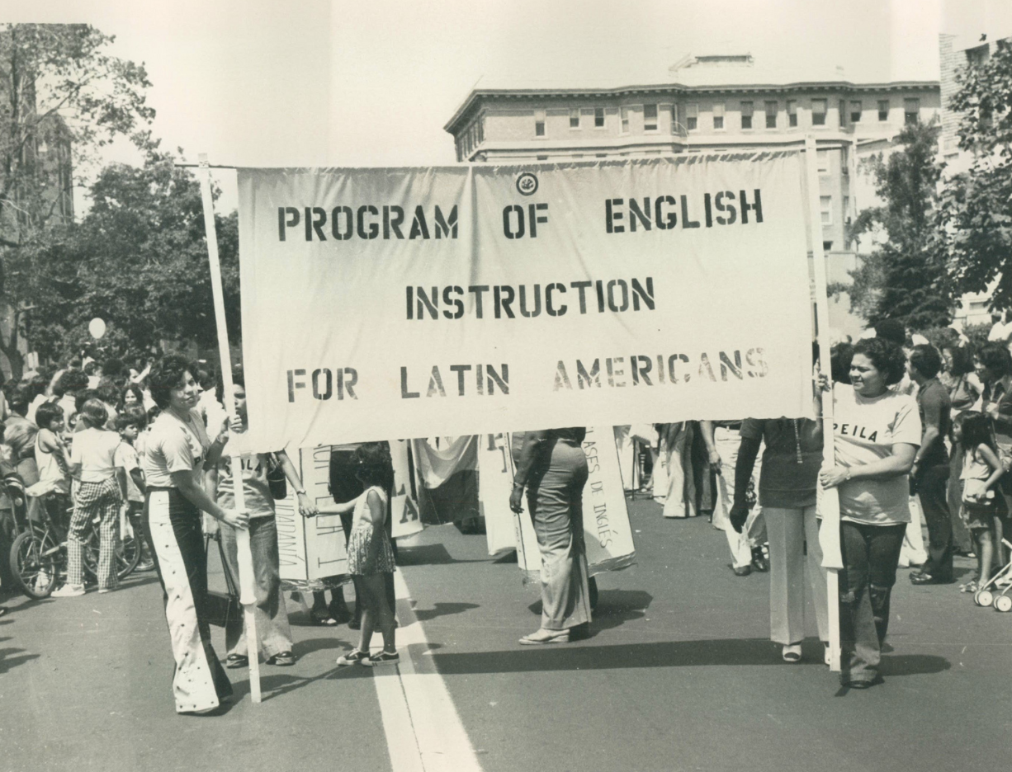
Challenges Faced by Latinos in the 1970s
Key challenges/obstacles
Building a political strategy
Engaging local leaders and students to become advocates
“Establishing credibility” by building programs and organizations

Slide 6
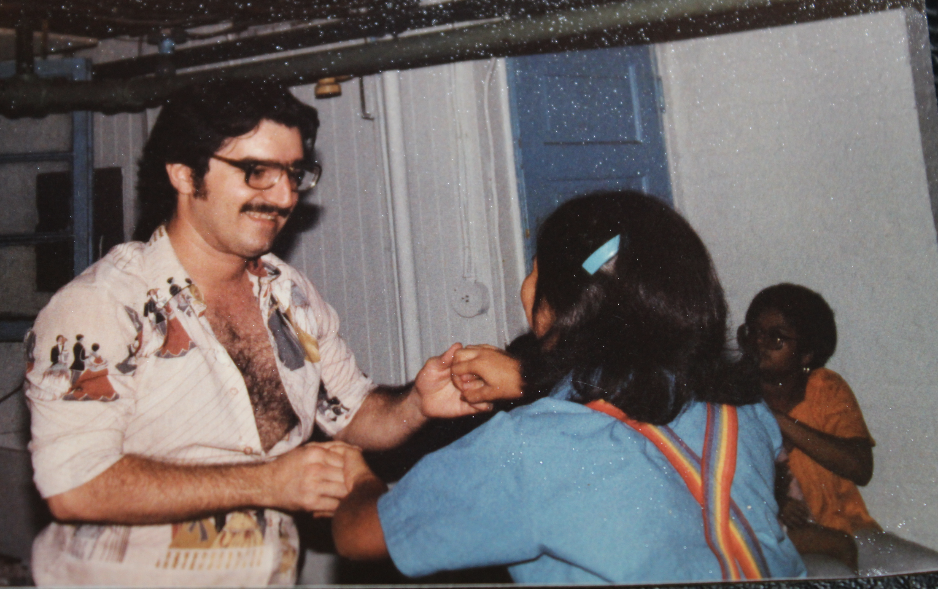
Creating a Space for Latino Youth in 1970s DC
José Sueiro
CEO, Santimarin & Associates

Slide 7
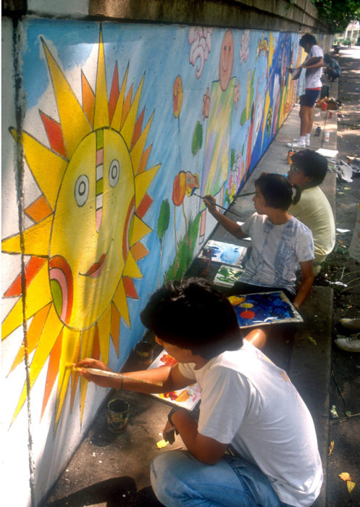
Creating a Space for Latino Youth in 1970s DC
Key challenges/obstacles I faced as a Latino youth during the 1970s
Role of first Latino youth-serving programs in development of programs and organizations that exist today
How Latin American Youth Center got started and my role in it
Photo credit: Latin American Youth Center

Slide 8
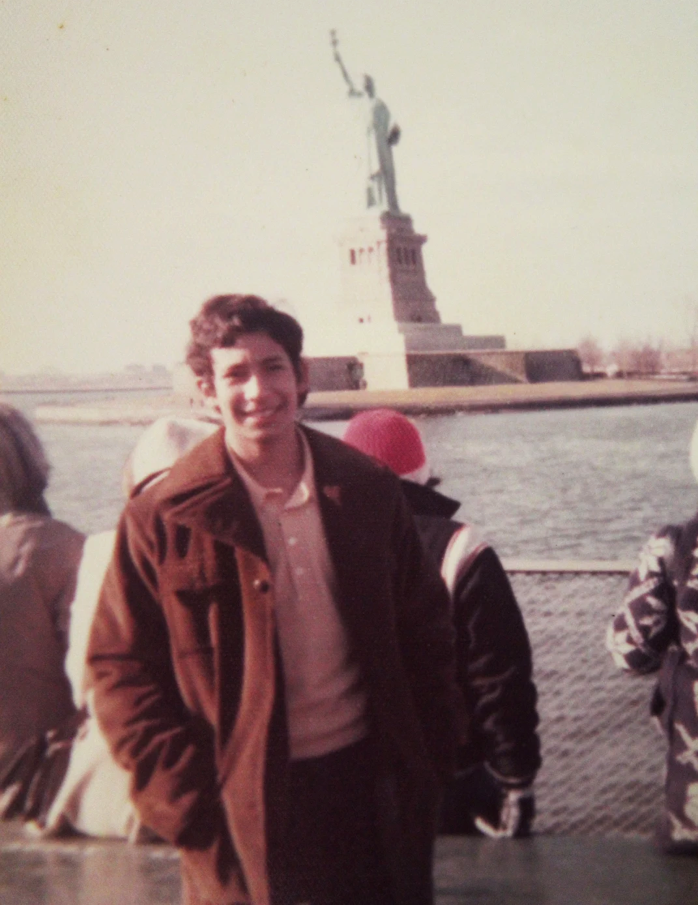
Consejos from a Latino Student Activist in 1970s DC
Pedro Avilés
Organizational Development Specialist Independent External Consultant

Slide 9
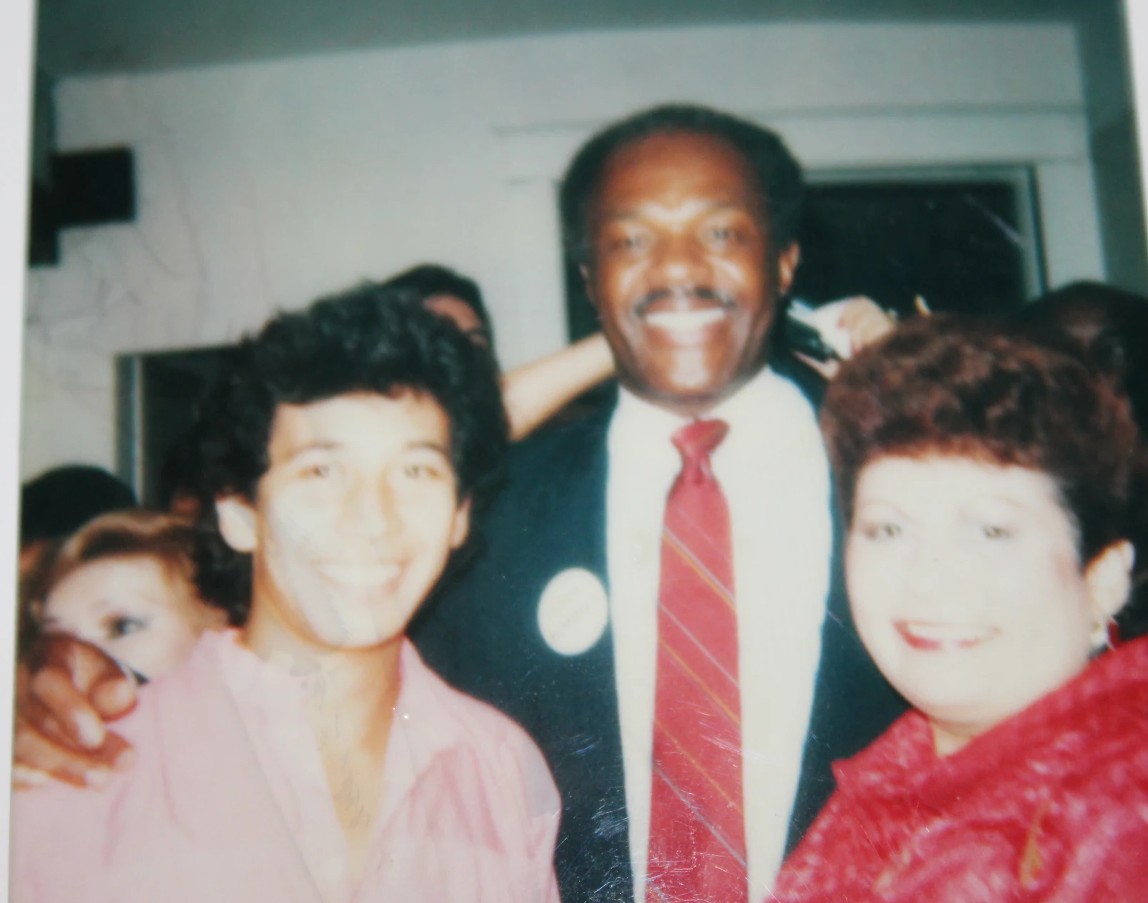
Consejos from a Latino Student Activist in 1970s DC
Build Community: Connections, Networks, Relationships—Build Power
Grow Your Self-Esteem: Stand Up for Your Rights—Respect, Dignity—Work, Study
Become Self-Actualized: Be, Do, and Become What Makes You Happy

Slide 10
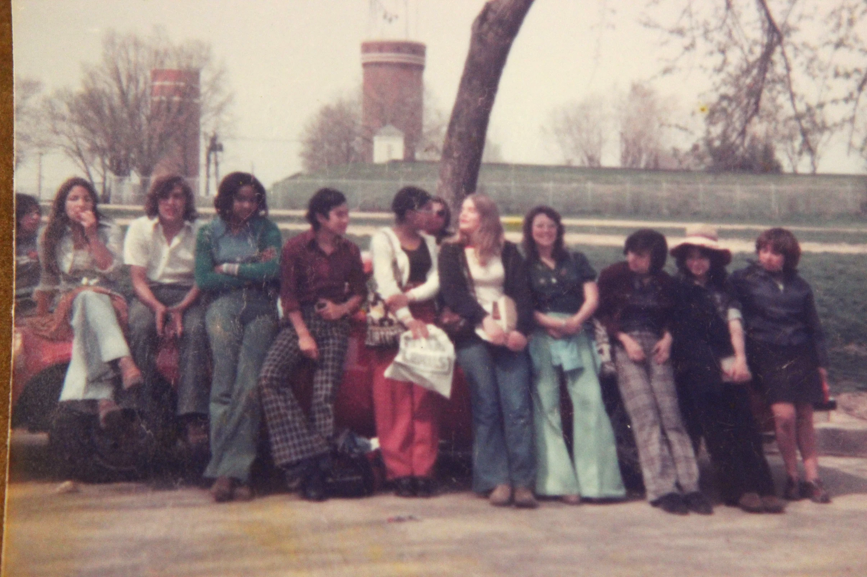
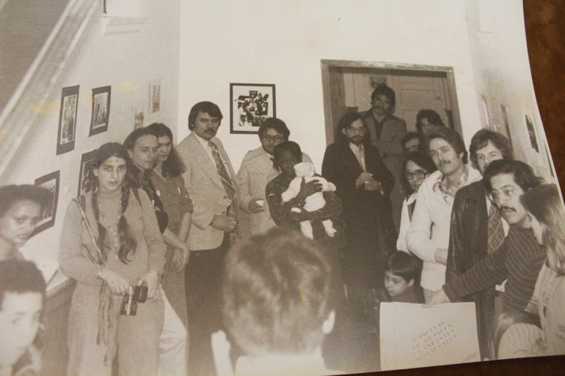

Slide 11
Saying “Presente” Today
Vanessa Magaña, Parent Advocate
Parents Amplifying Voices in Education
Student Services Program Assistant,
Carlos Rosario International PCS

Slide 12
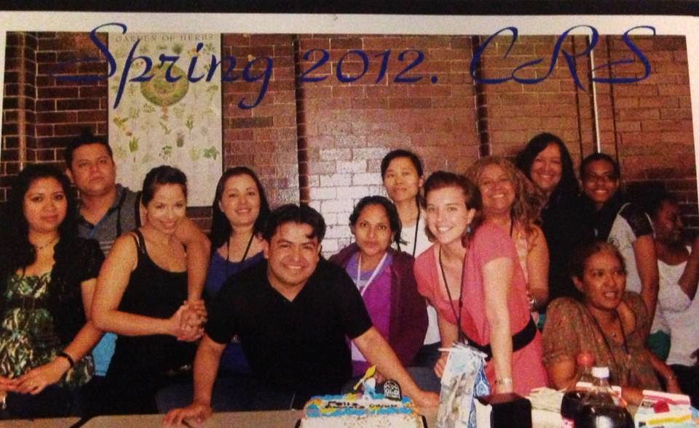
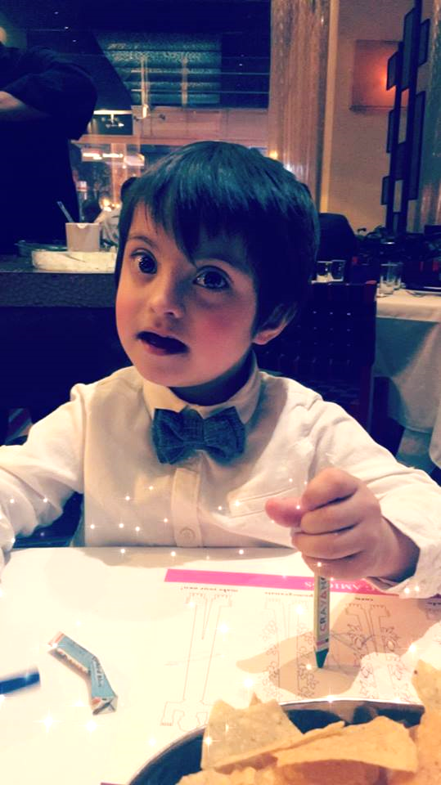

Slide 13
Q&A

Slide 14
Closing
Naomi Ayala, Collaborator

Slide 15
Thank you!
Gracias

