Slide 1
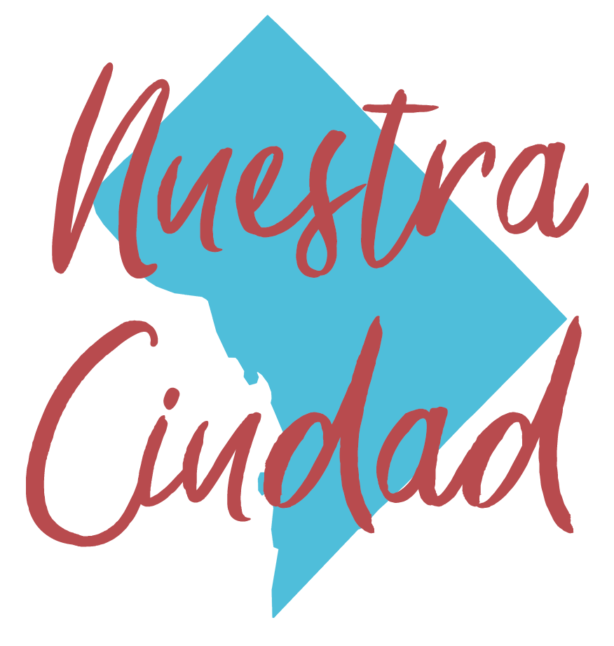
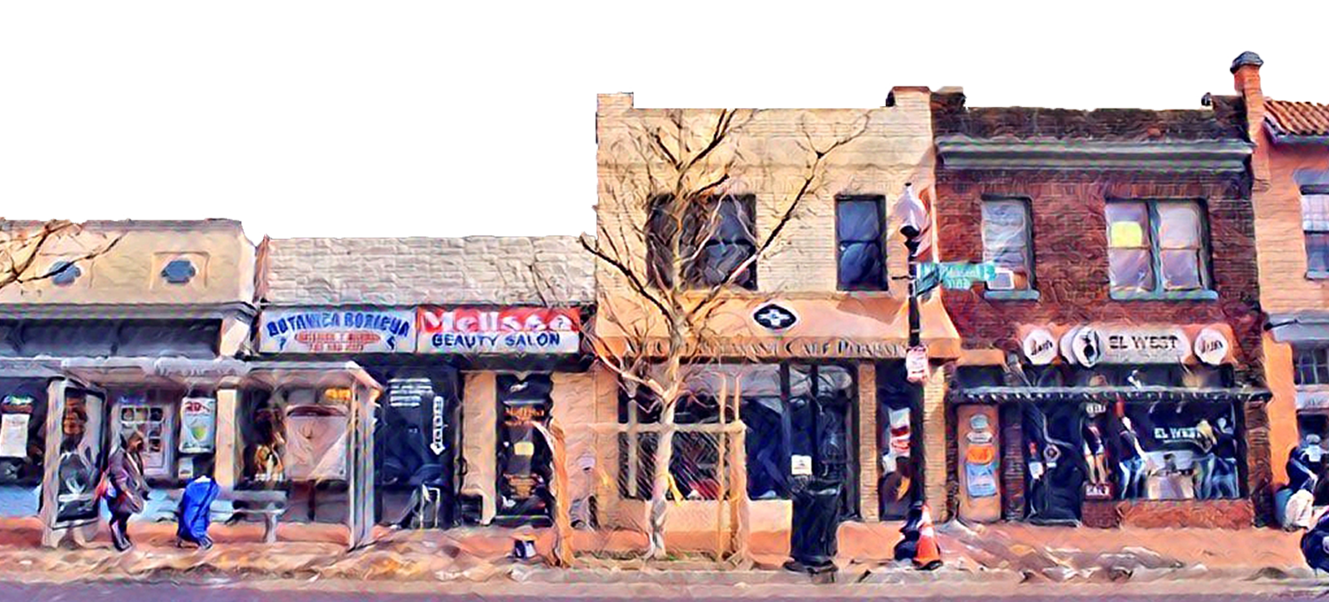
The Making of the Mayor’s Office on Latino Affairs
Presenters:
Sonia Gutiérrez and José Gutiérrez

Slide 2
Charla Framework
Events Leading to Latino Community Development Act
& Founding of MOLA
Community Organizing & Demonstrations
Role of Civic Education in Social Change
Outcomes of Latino Community Development Act

Slide 3
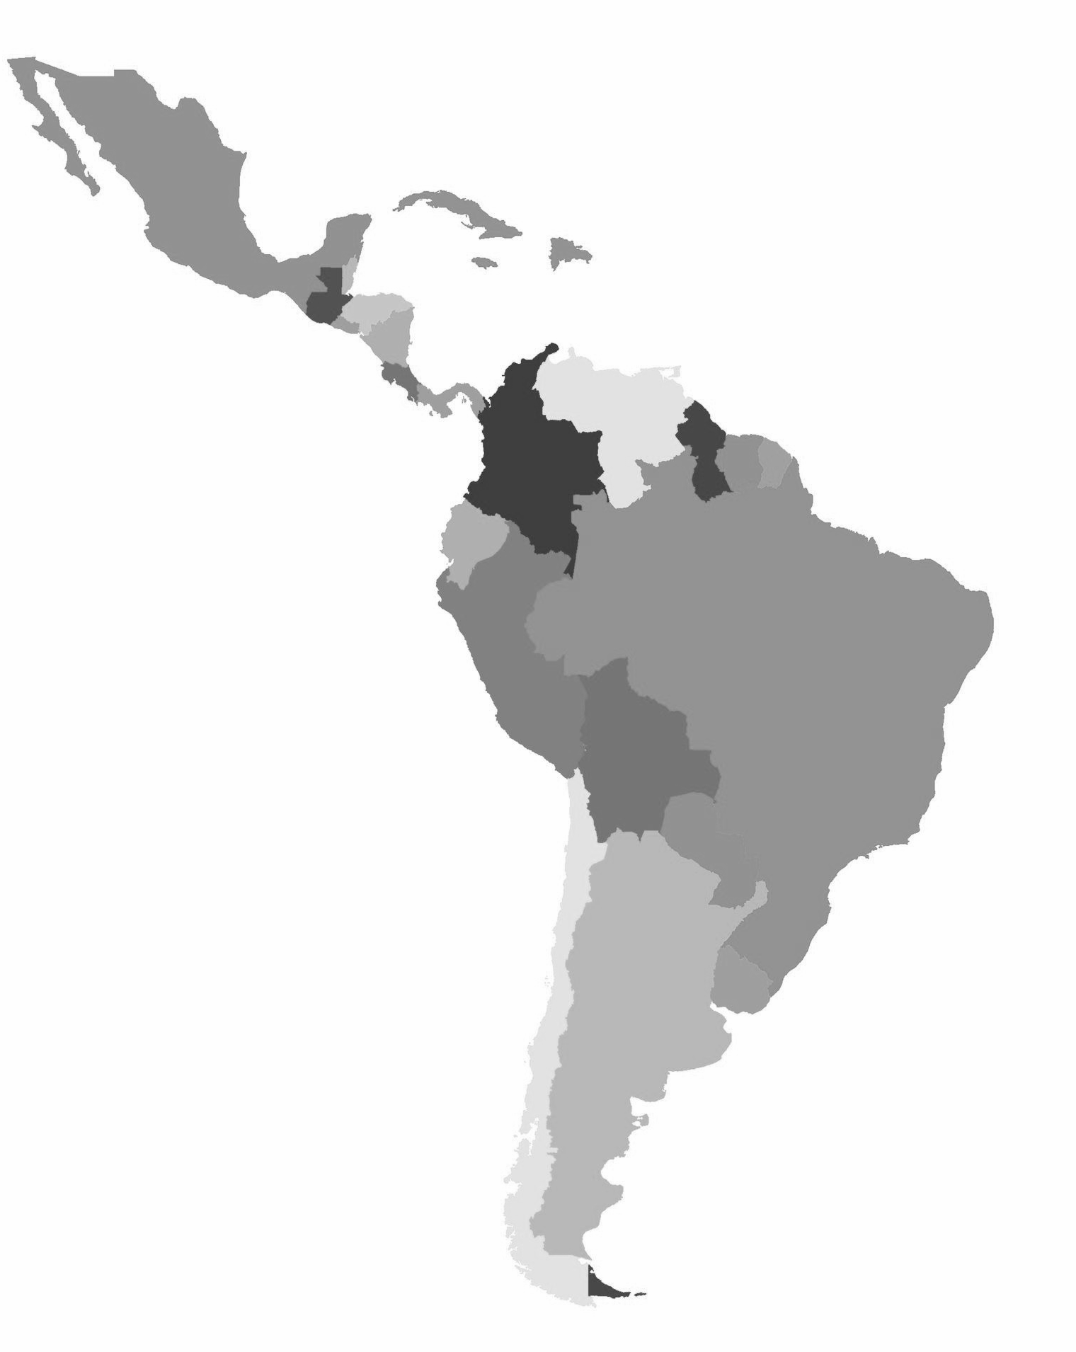
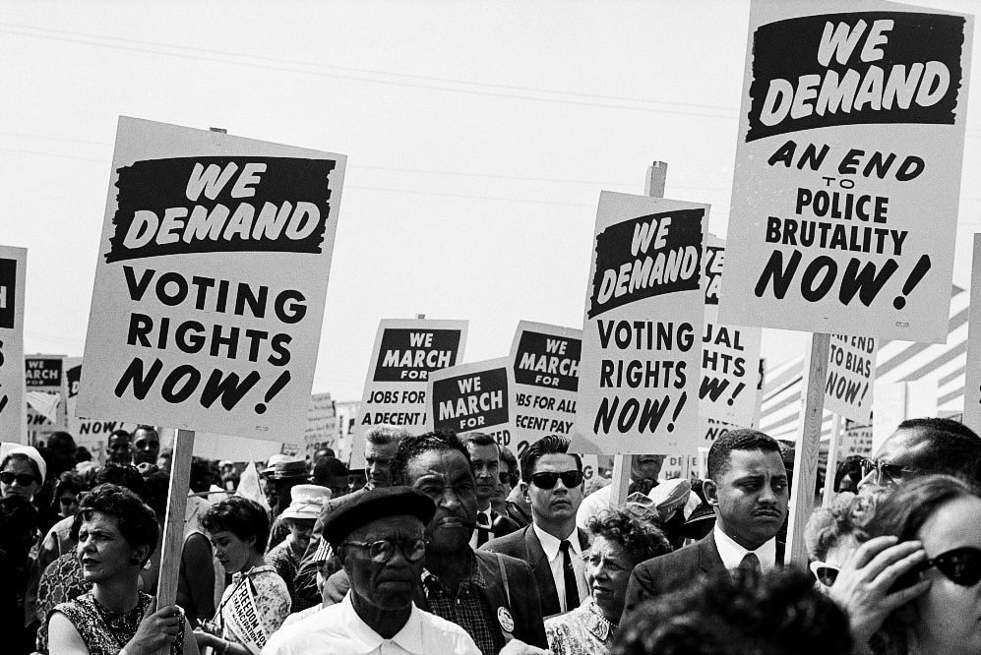
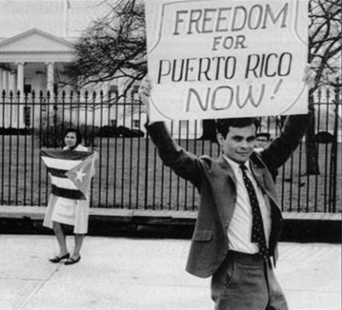
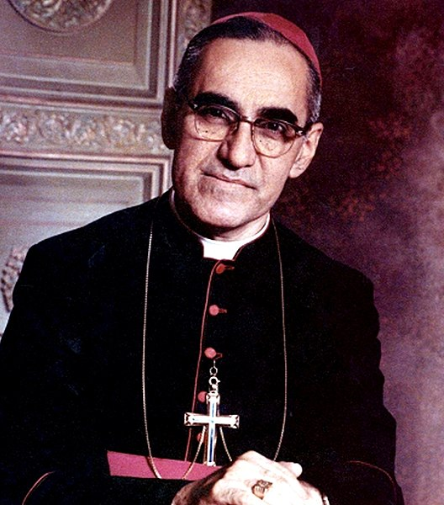
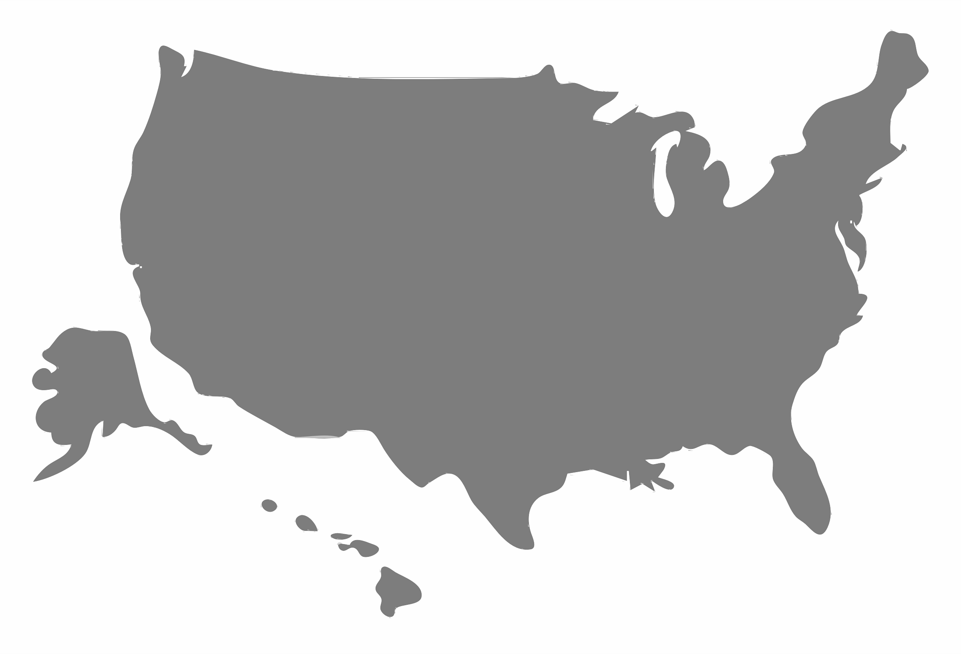
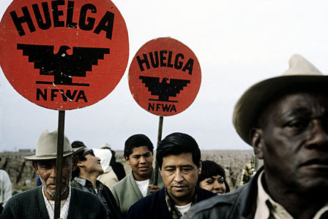
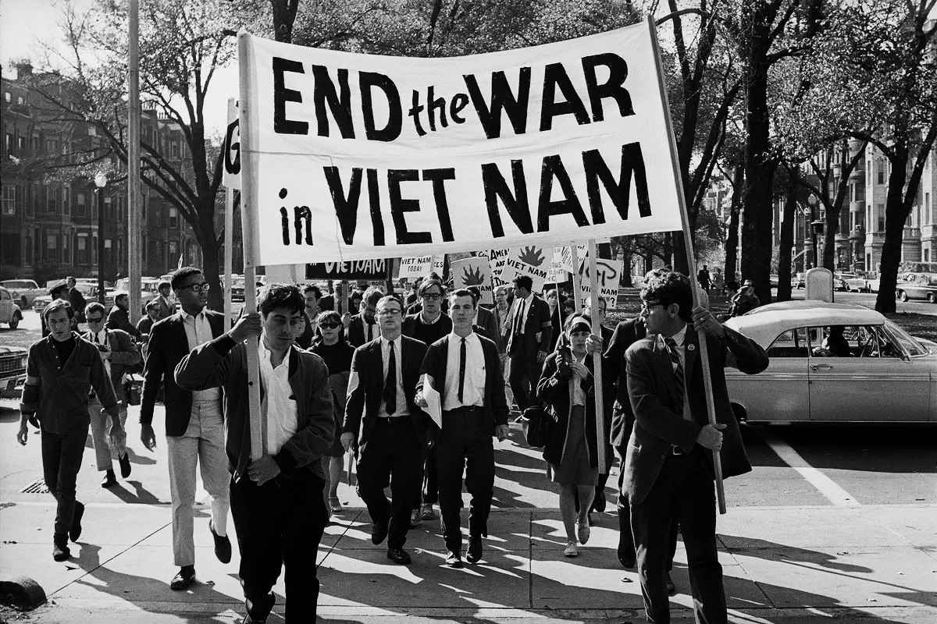
The Broader
Context (1966 - 1976)
Across the U.S. – Civil rights movements were in full force
In Latin America – People struggled for their lives in countries affected by civil war, dictatorships & political instability
LATIN AMERICA
UNITED STATES
Notes:
The Civil Rights Movement
Women’s Rights Movements
Anti-poverty programs
The Vietnam War
Student movements
Latino Civil Rights Movements including:
Chicano civil rights movement or El Movimiento!
Puerto Ricans, and Racial Justice, Anti-Colonial Movement in the United States.
FALN, FARC, El Salvador, Columbia, Contras in Nicaragua, the Peruvian Revolution, right-wing coup of Isabel Perón in Argentina
Liberation Theology in Christianity

Slide 4
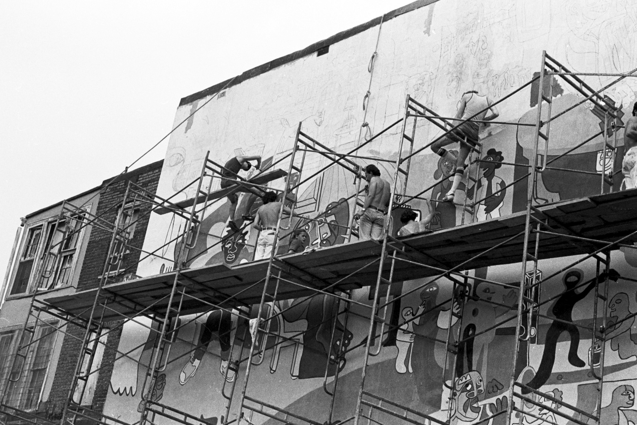
A PROFILE OF DC LATINOS IN 1970s
Homelands – The Caribbean, México, Central and South America
Reasons for Migration - Escape civil war & poverty, “seek a better life”
Making Home – Most settled in NW quadrant
Jobs – Predominantly, in service industries:
Hospitality
Restaurant & Food Service
Construction
Infrastructure work
The painting of "Un pueblo sin mural. . ." designed by Carlos "Caco" Salazar and Felipe Martínez, 1973 (12 Yrs that Shook & Shaped Washington: 1963-75, Anacostia Community Museum)

Slide 5
Events Leading Up to Creation of MOLA
DC Department of Human Services & Walter Washington move to close Office of Spanish-Speaking Affairs
Community responds with mass demonstrations grounded in civil rights and liberation theology movements
The Latino Community Development Act, DC Law 1-86, is created (cosponsored by Marion Barry, Polly Shackleton & John A. Wilson)
It is passed into law on September 29, 1976

Slide 6
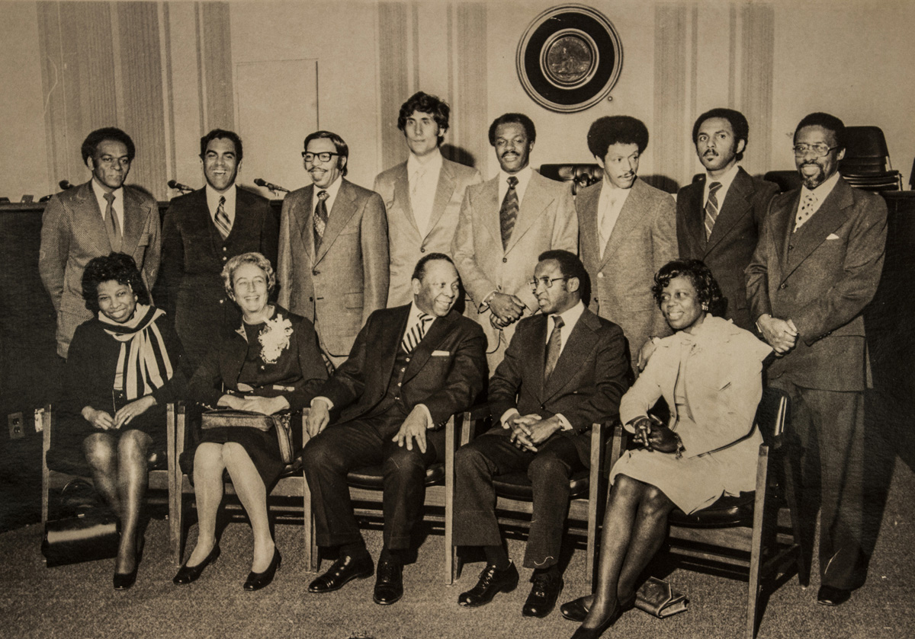
Council of the District of Columbia - 1975 Members
Sterling Tucker, Chair
Douglas E. Moore, At-Large Member
Julius Hobson, At-Large Member
Marion Barry, At-Large Member
Jerry A. Moore Jr., At-Large Member
David A. Clarke, Ward 1
John A. Wilson, Ward 2
Polly Shackleton, Ward 3
Arrington Dixon, Ward 4
William Spaulding, Ward 5
Nadine Winter, Ward 6
Willie Hardy, Ward 7
James Coates, Ward 8
First elected members of the DC City Council, 1975 (Photo courtesy DC Public Library, Washingtoniana Collection - 12 Yrs that Shook & Shaped Washington: 1963-75, Anacostia Community Museum)
Notes:
http://www.multivu.com/players/English/7723351-si-acm-12-years-shook-shaped-washington/

Slide 7
Sources of Ideas for Latino Community Development Act*
*From first draft to bill’s final copy, worked with Bruce C. French, who served as Legislative Counsel for DC City Council

Slide 8
The Greatest Obstacles Faced
Lack of Self-Government
The Mayor and City Council were appointed by U.S. President
Officials had no incentive to address civil rights or local community needs
Home Rule Act of 1973
The Act was brokered, coordinated & led by civil rights leaders
DC residents elected a Mayor & City Council members for first time in 1974

Slide 9
Creating Key Alliances
Reach out to Grassroots - First gather support of community & its leaders
Engage the Church - Enlist activist ministers, priests & other clergy
Build Coalitions - Engage other communities of interest
Involve Students - Make participation a “Lived Civic Education” learning experience
Build a Core Working Group - Identify those who have time & resources to coordinate, strategize & rally

Slide 10
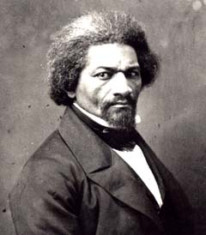
Key Lessons Learned
Community Leadership is about civic education
Organized activities & single-focus solutions created community gains & community pride
Adult Education is vital
It levels playing field & is key to building a stronger community
Power concedes nothing without a demand. It never did and it never will…
Frederick Douglass

Slide 11
What was needed to pull this off?
Fostered Civic Education & Mobilized
Moved volunteers into action
Led with advocacy
Organized group demonstrations, acts of civil disobedience
Had a Specific “Ask”
Focused on specific outcome (i.e., MOLA)
Worked Together
Learned to address conflict without confrontation & worked with one another
Community Organizing

Slide 12
Recommendations for New Generation of Latino Community Organizers & Activists
Mobilize Volunteers: Foster civic education
Lead with Advocacy: Participate in the political process
Get the Group to Deliver a Product: Choose specifics
Go for Concrete, Measurable Benefits: Housing, jobs,
economic development, access to capital, etc.
Address Conflict Without Confrontation
Learn “Demonstration Tactics”

Slide 13
What the Latino Community Development Act / MOLA Made Possible for DC Latino Community
CITY GOVERNMENT
Grants
Language Access
Police and Fire Department hires
Other DC Government job opportunities
Small Business Loans (many successful Latino-owned businesses, from restaurants to construction companies)
Housing Ownership
Citizenship
LATINO-SERVING CBOs
Carlos Rosario Public Charter School
Latin American Youth Center / Youth Build
Vida Senior Centers & Vida Senior Residences
Andromeda Transcultural Health
Ayuda Legal Services
CentroNía
CARECEN
Oyster School
La Clínica Del Pueblo
Mary’s Center
LEDC, Mi Casa & others
Better lives for ourselves & our children

Slide 14
Q&A

