Slide 1
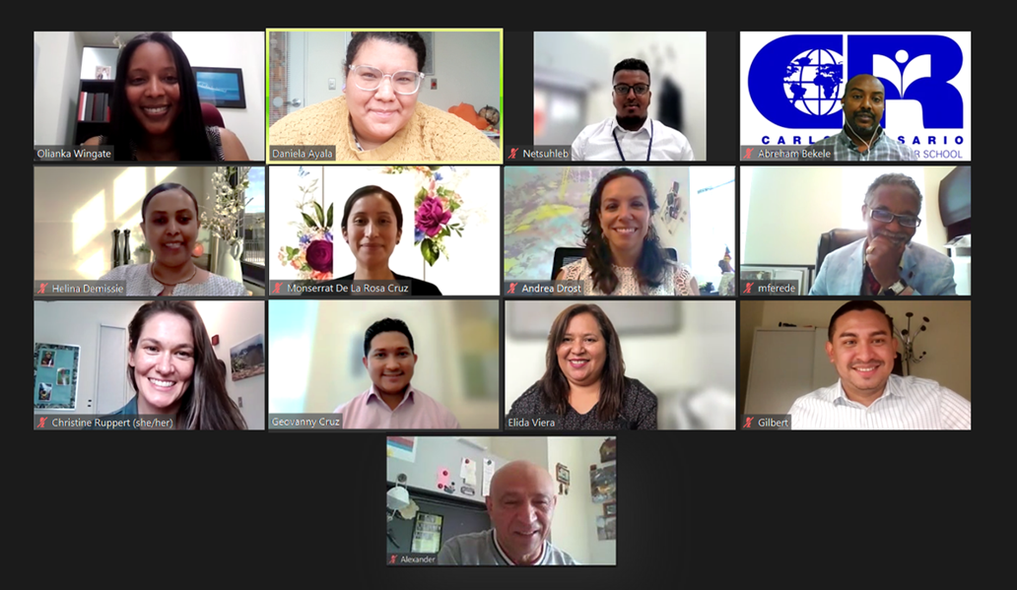
HARVARD CAMPUS
SDD TEAM
Olianka Daniela Netsuhleb Alex
Helina Monserrat Andrea Mengistu
Christine Geovanny Elida Gilbert

